Slide 1
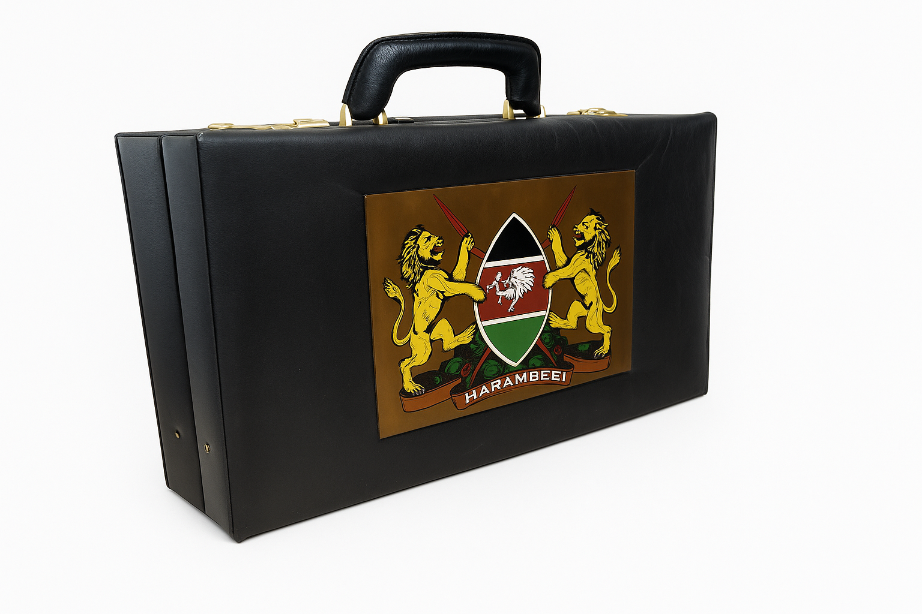
Unpacking Kenya’s National Budget.
Analysis of MDAs – Ministries, Departments & Agencies
Growing Together.
Unpacking Kenya’s National Budget.
Analysis of MDAs – Ministries, Departments & Agencies
Data Insights to Power the Bottom-Up Transformation.
PRE-SEED INVESTOR DECK

Slide 2
The Big Numbers……
Kenya’s 2024/25 Budget at a Glance
Ksh 3.9 Trillion – Total Budget Size
36%
Share allocated to debt servicing
14%
Share allocated to Education (Largest sectoral allocation)
Big Numbers, Bigger Questions
Kenya’s national budget allocations are large on paper, but execution gaps remain. Recurring discrepancies between approved budgets and actual expenditures raise concerns about efficiency, governance, and value for money.
12%
Allocation to infrastructure
7%
Allocation to health
Budget Watch for 2024-25 (Parliament of Kenya) — states a Ksh 3.9 trillion size of the budget. Parliament of Kenya
How Govt plans to spend Ksh.3.9 trillion in 2024/25 budget” — confirms the 3.9 trillion figure. Citizen Digital

Slide 3
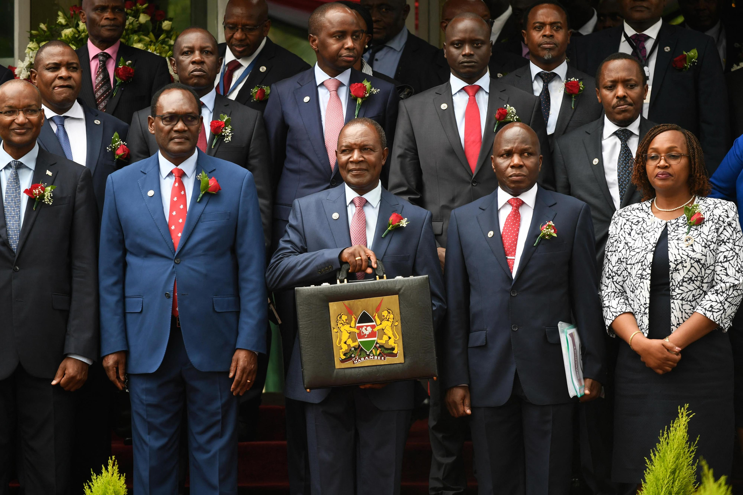
Growing Together.
PRE-SEED INVESTOR DECK

Slide 4
Problem
Big Allocations, Weak Execution
Kenya’s public funds must be allocated and utilized transparently to ensure accountability, efficiency, and value for money. Single-year audits often miss deeper patterns such as persistent underspending, overspending, or repeated audit concerns.
This raises critical questions:
Are recurring discrepancies between approved budgets and actual expenditures signs of inefficiencies, weak execution, or potential audit risks?
Over and above our findings, we understand that most citizens tend not to read and have access to these documents. Our aim is to create a search tool that will create public awareness among citizens.
This project investigates four financial years (2020/21 – 2023/24) of budget and expenditure data across national ministries, departments, and agencies (MDAs) to:
Detect recurring gaps between allocations and expenditures
Project Objectives
Highlight systematic inefficiencies and weak budget executions
Flag potential audit concerns and governance risks.
Provide actionable insights for policymakers, oversight bodies, and civil society.
Budget Watch for 2024-25 (Parliament of Kenya) — states a Ksh 3.9 trillion size of the budget. Parliament of Kenya
How Govt plans to spend Ksh.3.9 trillion in 2024/25 budget” — confirms the 3.9 trillion figure. Citizen Digital

Slide 5
Data Understanding and Preparation
This project draws on official Auditor-General reports, which provide the authoritative record of Kenya’s national government budgets, expenditures, and audit observations.
Data Sources
Auditor-General Reports (2020/21–2023/24): authoritative, audited actuals and observations.
National Govt Budget “Blue Book” (2021/22): approved estimates at vote/program level: baselines for approved budgets across MDAS.
Kenya_National_Govt_Budget_2021_2024.csv– Structured, machine-readable dataset (2021–2024).– Enables stats, joins, and year-to-year checks.
MDAs Report 2023/24 (PDF)– Detailed vote-level audit opinions.– Includes “Budget vs Actual” statements and systemic issues (pending bills, late releases, control weaknesses).
Why Suitable
Government-issued, official, and comprehensive
Directly aligned with the problem: budget allocation vs execution

Slide 6
Data Understanding and Preparation
Data Preparation & Structure
Planned Extraction
Used Python PDF tools (pdfplumber) to extract budget vs actuals, appropriation summaries, and control/performance notes.
Normalized MDA names across years to account for mergers/renaming.
Build Unified Dataset
Key fields: MDA, Financial year, approved budget, actual expenditure, variance, % variance, audit observations.
Data Size: Several hundred rows (all MDAs × 4 years).
Descriptive Stats Computed
Approved vs actual totals, averages, variance distributions.
Frequency of underspending, overspending, or within tolerance.
Audit observations categorized (procurement, unsupported spending, late releases).
Limitations & Mitigation
Format inconsistencies: Hybrid extraction + manual cleaning.
Name changes: Canonical mapping maintained.
Accounting/reporting differences: Documented assumptions.
Qualitative audit notes: Structured tags + confidence flags.

Slide 7
Data Cleaning for Financial Analysis and NLP
From Raw PDFS to clean Data
Raw Data Challenges
Budget reports came in PDFs with messy tables & text.
Inconsistencies in ministry names (mergers, abbreviations, duplicates).
Budgets had commas, spaces, and text fragments instead of numbers.
Noise rows (like “TOTAL” or “BALANCE”) distorted calculations.
Cleaning Actions Taken
Standardized and normalized MDA names across years.
Cleaned and converted budget figures into usable numeric format.
Applied NLP to parse unstructured audit text, extract ministries, years, and amounts, and tag recurring audit concerns.
Removed noise rows and impossible values (e.g., < KSh 1000).
Aggregated duplicates to ensure one row per MDA per year.
Created variance and % variance columns to enable comparability.
Outcome
Built a unified, machine-readable dataset covering 4 years and 100+ MDAs.
Dataset is now accurate, consistent, and ready for analysis.
Allowed computation of core features (utilization rate, spending status, audit flag).
Additionally, we enhanced the dataset with new features such as Utilization Rate, Spending Status, and Audit Flags — enabling deeper insights into inefficiencies and risks
CONFIDENTIAL

Slide 8
On Budget:
16.7%
very few MDAs achieve execution discipline.
EDA
Budget Execution Patterns Across MDAs
Majority of government entities are not effectively executing their budgets as planned. The significant underspending (50.4%) suggests potential inefficiencies in budget implementation, delayed projects, or poor financial planning. Overspending (33%) indicates possible budget miscalculations or unexpected expenditures.
Overspent:
33%
possible budget miscalculations, reliance on supplementary budgets, or unplanned emergencies.
Most MDAs deviate significantly from approved budgets — a clear sign of systemic execution challenges.
Underspent:
50.4%
inefficiencies in budget absorption, delayed projects, or weak financial planning.

Slide 9
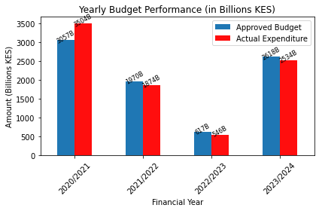
Yearly Budget Performance
The variance between approved and actual spending across the categories suggests inconsistent financial management practices, where some MDAs (ministries/departments/agencies) overspend while others underspend. This points to the need for more evidence-based budget allocations and capacity building in implementation.
Note:
The Ministry of Health received a significant increase in 2020/21 to address COVID-19 priorities.

Slide 10

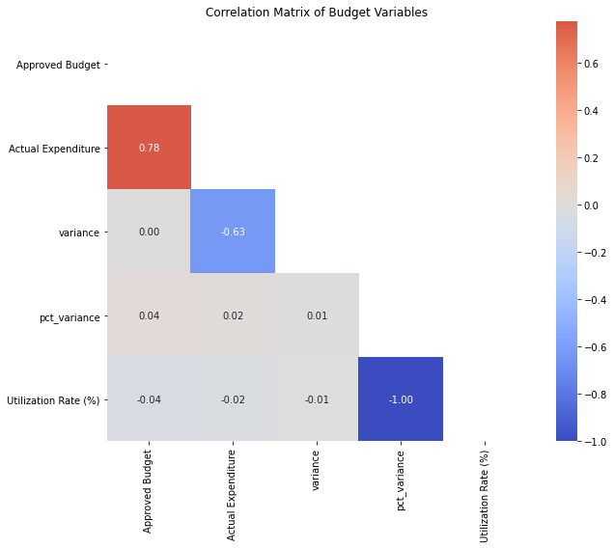
Correlation Between Budget Variables
Key Insights:
Approved vs Actual Expenditure: 0.78
Budget size vs % Variance: 0.04
Utilization vs Actual Expenditure: -0.02
Key Takeaways:
Approved vs Actual Expenditure (0.78 – Strong Positive Correlation)
Spending closely aligns with approved budgets, indicating good financial discipline. However, some outliers may still require review.
Budget Size vs % Variance (0.04 – Very Weak Correlation)Budget accuracy is unrelated to size — both large and small budgets face similar execution challenges, pointing to systemic inefficiencies.
Utilization vs Actual Expenditure (-0.02 – No Correlation)Virtually no link between utilization and expenditure. This is unexpected, as utilization is typically derived from actual expenditure. A weak negative correlation may suggest a wide variability in approved budgets that distorts the relationship.

Slide 11
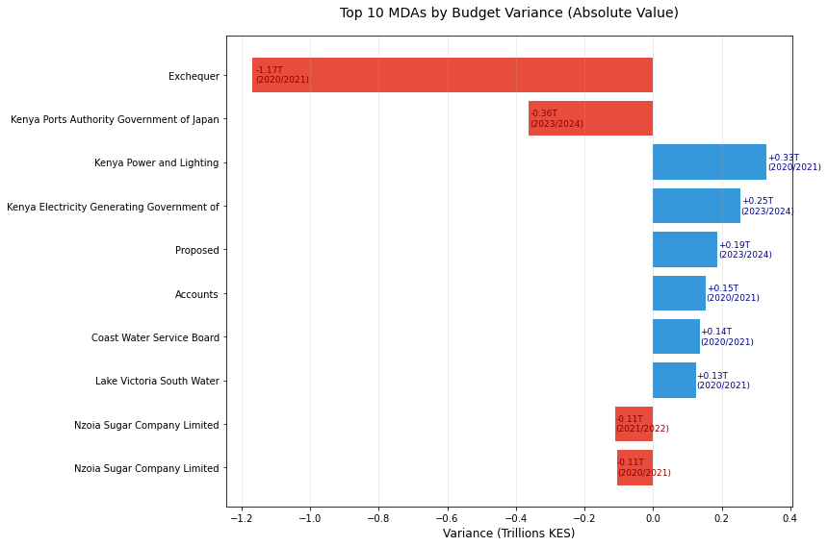
Top 10 MDAs by Budget Variance (2020–2024)
The top 10 MDAs account for the largest budget deviations, either through massive underspending or extreme overspending. Together, these agencies explain the bulk of inefficiencies in Kenya’s national budget execution.
Key Insights:
Total underspending: 1.79T went unused.
Across all MDAs, approximately KSh 1.79 trillion of allocated funds went unused indicating inefficiencies in budget absorption (projects not implemented, delayed, or over-allocated).
Total overspending: -1.98T spent beyond approved budgets.
Around KSh 1.98 trillion was spent beyond approved budgets, reflecting weak fiscal discipline and reliance on supplementary allocations.
Largest underspending: 1.17T
A single MDA overspent by nearly one-third of Kenya’s annual budget — an extreme outlier and a clear audit red
Policy Implication:
Kenya faces a systemic issue almost equal magnitudes of under- and overspending, both in the trillion-shilling range. Very few MDAs achieve full alignment with their approved budgets, highlighting persistent weaknesses in fiscal planning and execution.

Slide 12
Hypothesis Testing:
Spending Patterns Across MDAs
 | Observed Distribution | Expected if balanced (~92 each):
Overspent | 91 | 92
Underspent | 139 | 92
On Budget | 46 | 92
Key Insights
Since p-value ≪ 0.05, we reject H₀.
This means the distribution of MDAs across Overspent / Underspent / On Budget is not equal.
In other words, there’s a systematic bias:
Most MDAs are underspending (139 vs expected ~92).
Very few MDAs are On Budget (46 vs expected ~92).
Overspent MDAs (91) are close to expected but still part of the imbalance.
This means the distribution of MDAs across Overspent / Underspent / On Budget is not equal. This reveals that there’s a systematic bias:
Policy / Audit Implication(Hypothesis Testing)
The bias toward underspending may indicate:
Delayed fund disbursement,
Poor absorption capacity,
Overestimation during budget approval.
The fact that "on budget" performance is rare might indicate:
Lack of accurate forecasting
Weak budget execution controls
This result supports the need for:
Budget execution reforms
Capacity building
Better monitoring and evaluation
Chi-square Statistic: 47.02p-value: P-value:6.156857231834227e-11
Decision: Reject H₀

Slide 13
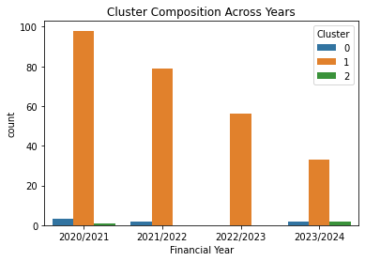
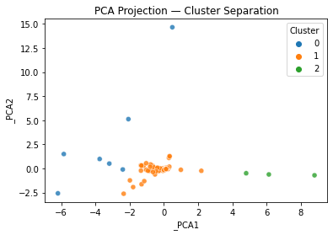
Clustering Analysis
Spending Behavior Clusters Across MDAs
We used KMeans clustering to group MDAs based on budget, utilization, and variance the goal is to identify spending behavior patterns such as efficient users, under spenders, and over spenders.
Three clusters emerged:
Cluster 0: Efficient spenders — high utilization, low variance.
Cluster 1:Under spenders — low utilization, large positive variance.
Cluster 2: Over spenders — negative variance (spent more than allocated).
Next steps:
- Prioritize audits for high-budget MDAs in risky clusters.
- Use cluster membership in dashboards to flag anomalies.

Slide 14
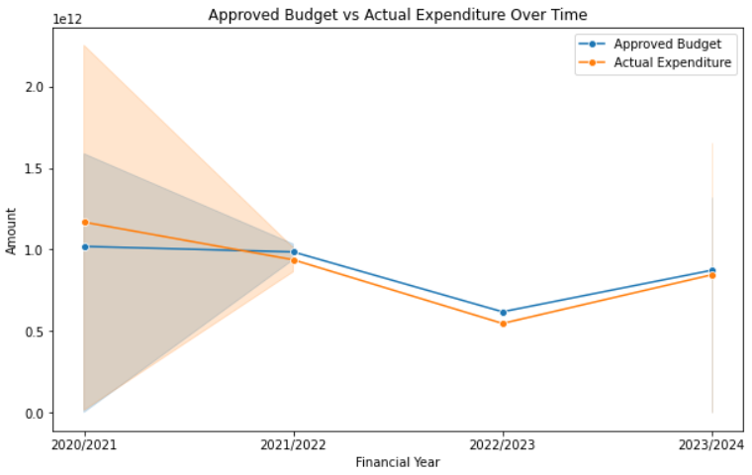
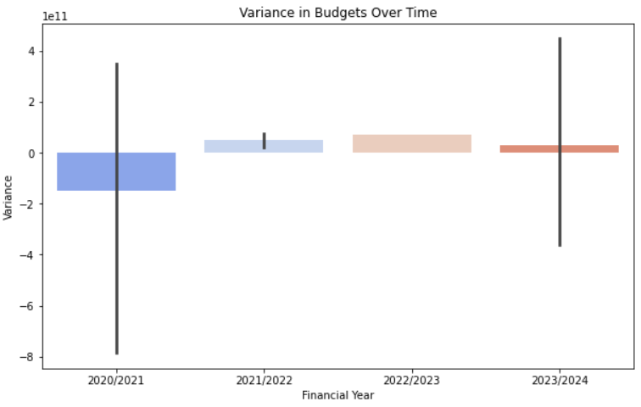
Budget and Expenditure Trends Over Time
Key Insights
Insights from Trend Analysis
Budget Growth: Approved budgets have generally increased across years.
Expenditure Gaps: In some years, expenditures lag behind allocations, creating under-utilization.
Variance Trends: Variance spikes in certain years suggest inefficiencies or unspent funds.
These findings can guide fiscal policy and highlight years where budget execution needs scrutiny.

Slide 15

Feature Engineering & Modeling Outcomes
Model Performance
Interpretation:
RMSE dropped dramatically
R² jumped from 0.20 to 0.90, meaning the model now explains about 90% of the variance in Approved Budget.
The baseline TF-IDF + Linear Regression model performed poorly, indicating that budget allocations cannot be captured using text alone in a linear framework. The tuned XGBoost model achieved an RMSE of ~3.68e11 and R² of ~0.90, showing a substantial improvement. This suggests that budget allocations follow systematic patterns tied to ministries, entities, and project descriptions. The model can provide valuable insights for predicting future allocations and identifying anomalies.
Baseline TF-IDF + Linear Regression
RMSE: 10572303235851.764
R²: 0.200451509032037
These baseline results (RMSE ~ 1.0e11; R² ~ 0.20) show that the TF-IDF + Linear Regression model is doing worse than a trivial predictor (mean of Approved_Budget). This R² means the model’s errors are larger than simply predicting the mean for all samples
XGBoost (with numeric + categorical + text features):
RMSE ≈ 368904739458.20844
R² ≈ 0.90

Slide 16

Insights and recommendations
Financial & Policy Recommendations
Address Chronic Underspending. Several MDAs consistently underspend their approved budgets. This points to absorption challenges and inefficiencies in project execution. Action: Review procurement and implementation bottlenecks, and revise budget ceilings for recurrent underspenders to better align resources with capacity.
Tighten Oversight on Overspending MDAs. Overspending cases pose significant financial risks. Action: Establish a red-flag threshold (e.g., >120% budget utilization) that automatically triggers audits or closer monitoring.
Audit Prioritization Using Clusters. With nearly 70% of MDAs flagged, resources for auditing should be allocated strategically. Action: Prioritize overspenders and extreme underspenders, while maintaining light-touch monitoring of efficient MDAs.
Improve Budget Forecasting & Planning. Persistent variance between approved budgets and actuals suggests weak forecasting mechanisms. Action: Require evidence-based justifications for allocations,and apply historical performance trends when setting future ceilings.
Capacity Building for Low-Performing MDAs. Low utilization rates often reflect weak planning and reporting capacity. Action: Provide training and technical support, simplify fund disbursement procedures, and strengthen accountability frameworks.
Strengthen Budget Formulation. Require MDAs to justify allocations with detailed implementation capacity assessments (staffing, procurement readiness, past absorption rates). Adopt evidence-based budgeting where future allocations are tied to past budget utilization trends.
Introduce Performance Contracts. The senior management performance appraisals to budget absorption KPIs (e.g., ≥90% execution rate). Use dashboards to flag anomalies in real time (based on cluster membership).
Capacity Building & Digitalization. Train MDA finance departments on planning, reporting, and monitoring. Enhance the Integrated Financial Management Information System (IFMIS) to automatically track variance and trigger alerts.

Slide 17
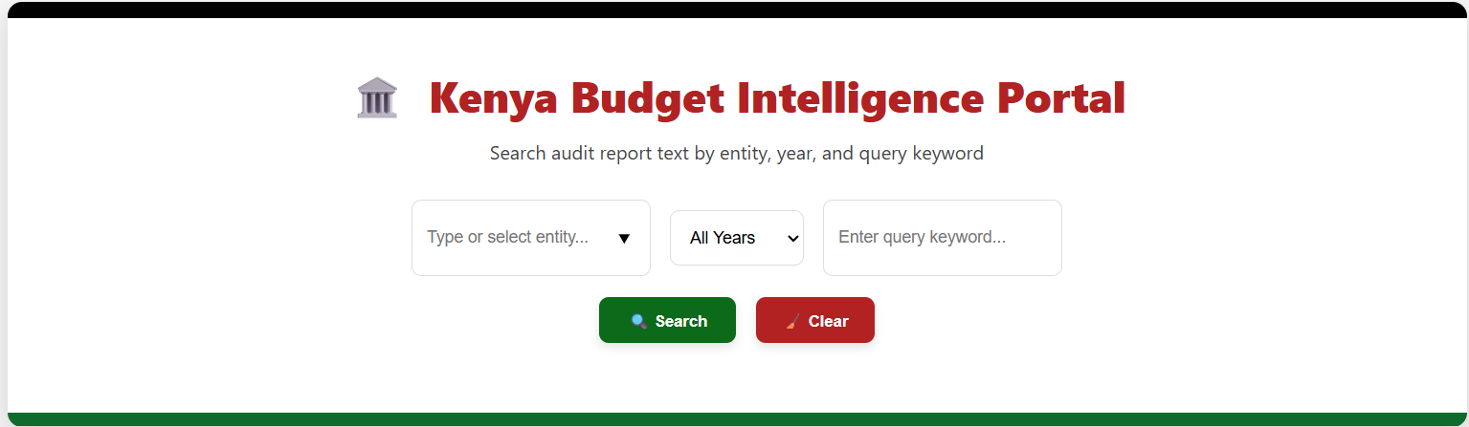
Search Tool Deployment and Tableau
Tableau Dashboard: View Budget Performance Dashboard
Deployed Model (Heroku): Access the Kenya Budget Analysis App

Slide 18
Thank You!
Contact Information:
erastus@gmail.com lucianandanu9@gmail.com
irenekibengo@gmail.com
bensonmwihia@gmail.com
danakwabi@gmail.com
sydneywere563@gmail.com

